Slide 1


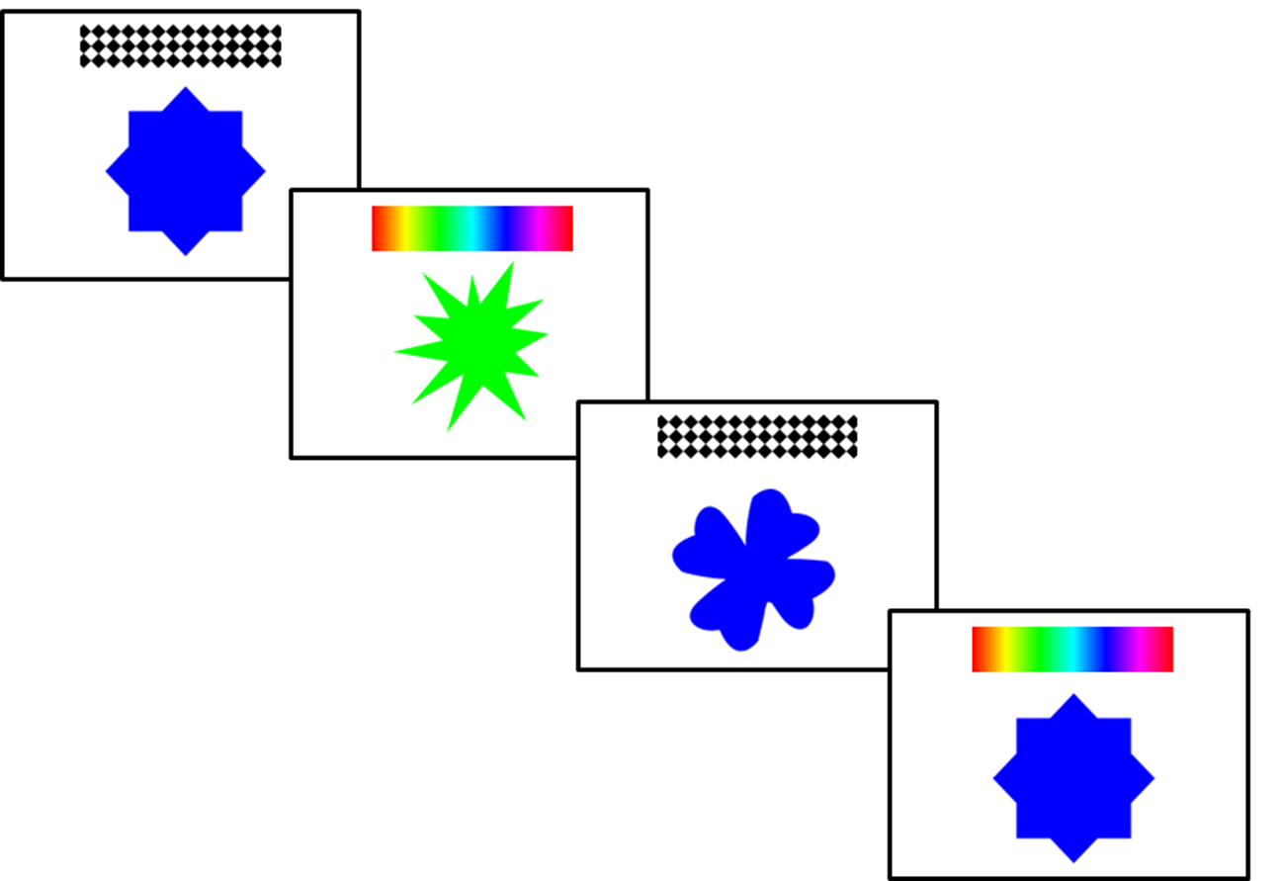

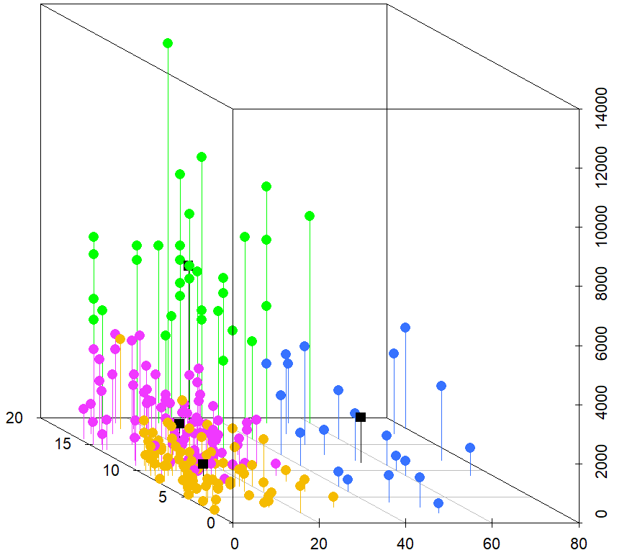
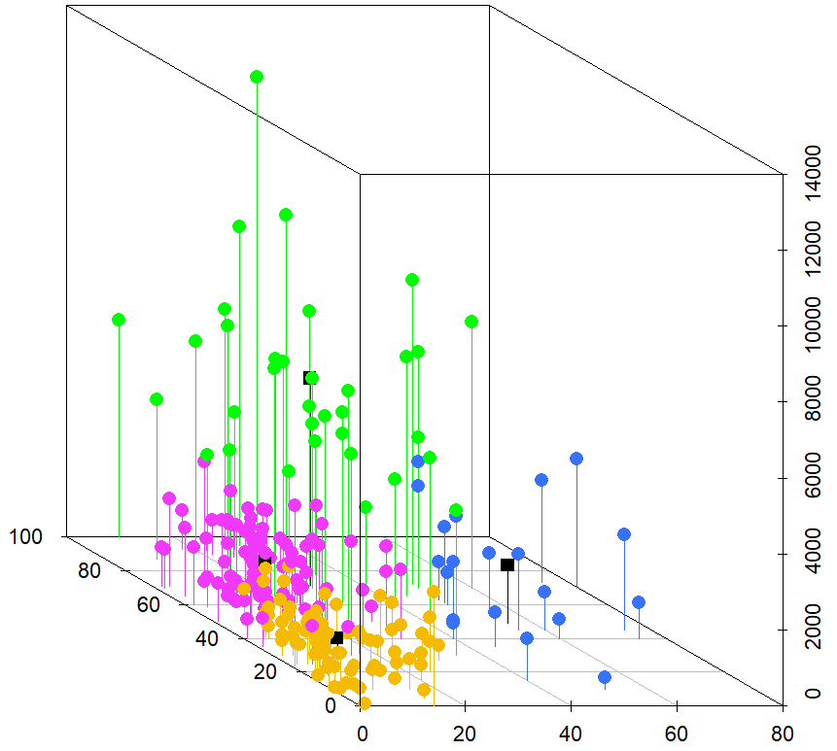

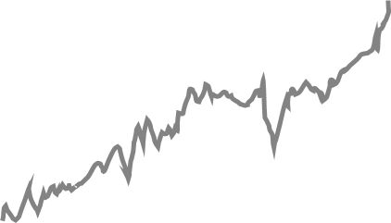


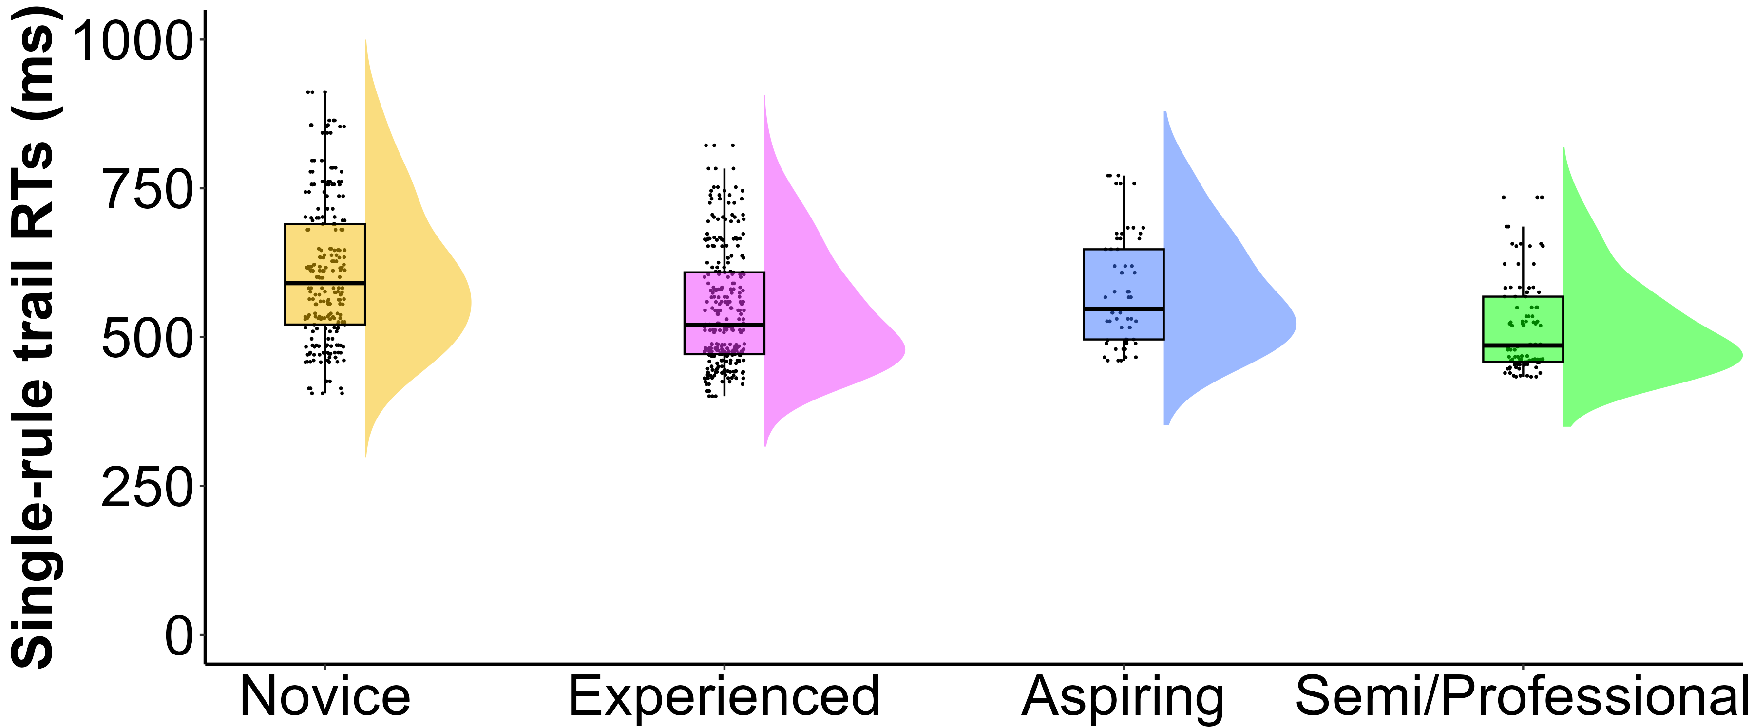
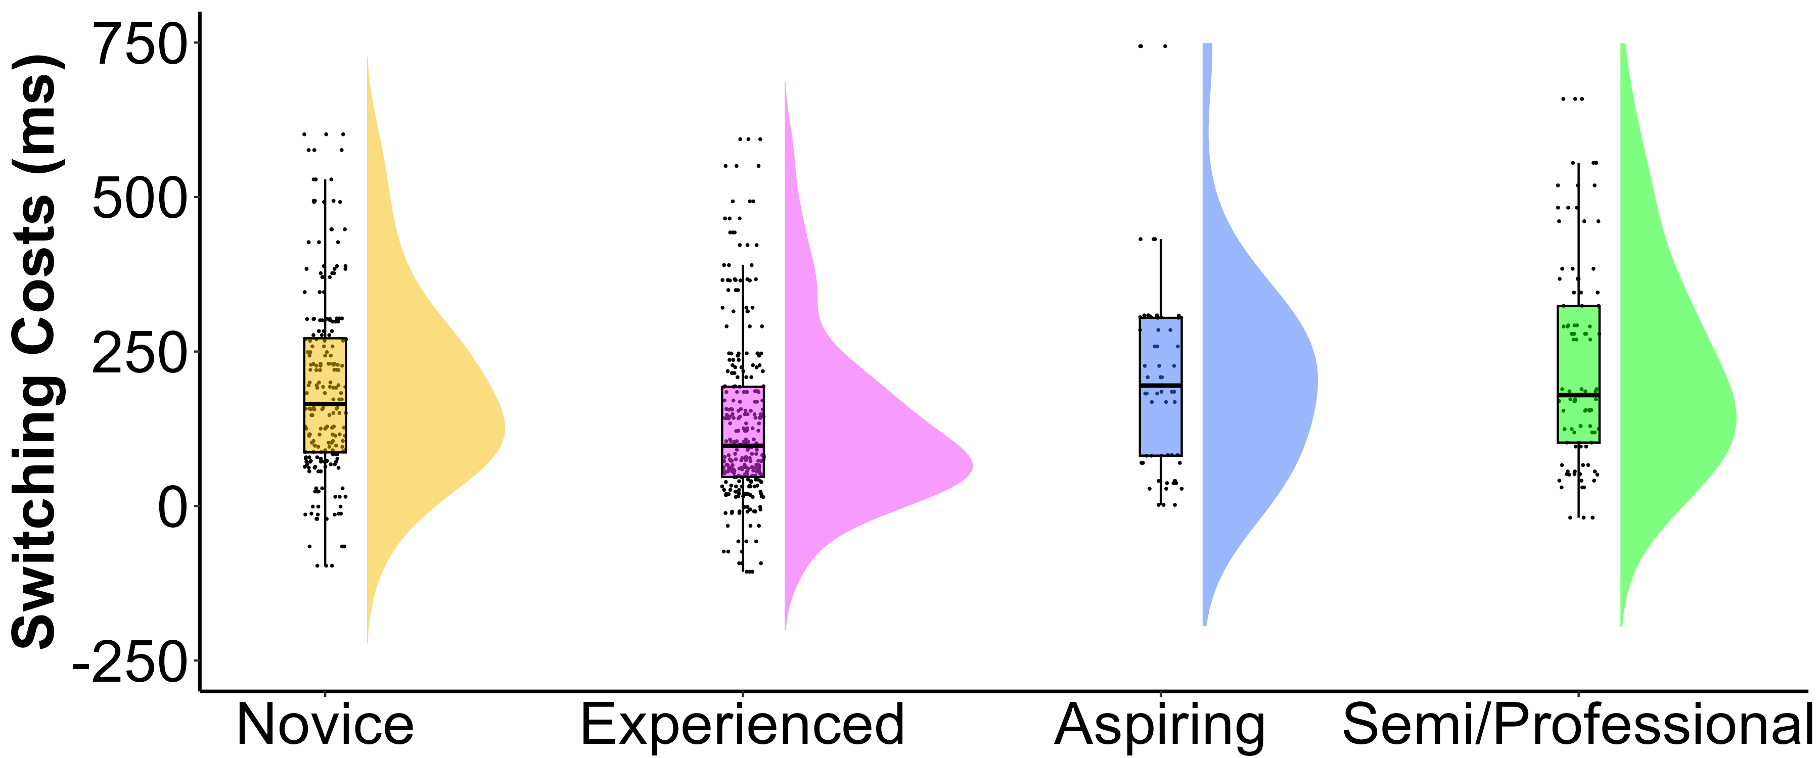
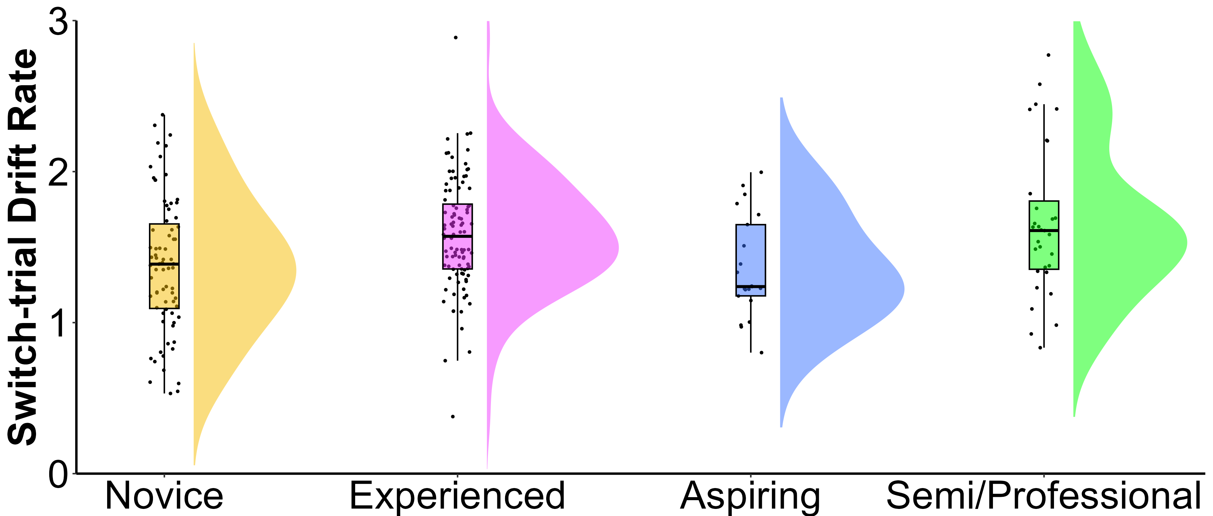
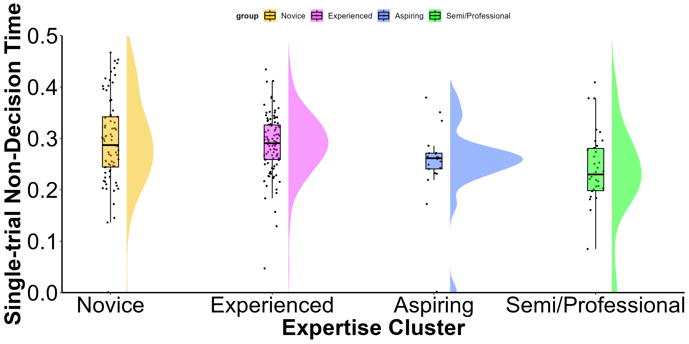
Processing Speed and Multitasking Performance in First-Person Shooter Players:
A Drift-Diffusion Model Approach
Eleanor R. A. Hyde, Robert Schmidt, Daniel J. Carroll, & Claudia C. von Bastian
erahyde1@sheffield.ac.uk www.eleanorhyde.com @erahyde.bsky.social www.claudiavonbastian.com
Background
Method
Video games provide a unique sandbox for studying cognition, with fast-paced First-person Shooter (FPS) games, like Counter-Strike, posing significant cognitive challenges.
Prior research links FPS play to better multitasking but often confounds it with processing speed using absolute reaction times (RT).
Studies have also used small samples of novice players, limited expertise measures, and mix video game genres.
This research assesses multitasking and processing speed in diversely experienced Counter-Strike players.
Choice RT Task
Counter-Strike Expertise Questionnaire
Shape trial
Colour trial
Shape trial
Colour trial
Participants
The Drift-Diffusion Model
N = 230
Correct response
Decomposes RTs and accuracies into distinct components to give insight into cognitive mechanisms underlying performance differences in decision making.
Drift Rate (v): evidence accumulation.
Boundary Separation (a): response caution.
Non-decision time (t0): stimuli encoding and response execution.
Total hours playtime
Total hours playtime
Starting point
Boundary Separation
Drift rate
Incorrect response
Current Ranking
Weekly hours playtime
Self-rated expertise
Weekly hours playtime
Novice n = 77 Experienced n = 98 Aspiring n = 21 Semi/Professional n = 34
Stimulus encoding
Decision time
Response execution
Results
Very strong evidence for a main effect of expertise cluster:
Substantial evidence for a main effect of expertise cluster:
Substantial evidence for a main effect of expertise cluster:
Decisive evidence for a main effect of expertise cluster:
Semi/Professional players showed:
Faster processing speed (RTs) in single-rule trials without sacrificing accuracy.
Greater information accumulation efficiency in challenging switch trials, shown by higher drift rates (v)
Faster encoding and response execution in simpler single-rule trials, shown by shorter non-decision times (t0).
Experienced players showed:
More efficient switching between tasks, shown by lower switching costs compared to more expert players.
Conclusion
FPS expertise is a complex and non-linear construct, measurable through readily available objective metrics.
FPS expertise relates to faster stimuli encoding and response execution in simple decision-making trials, and evidence accumulation in more complex decision-making trials.
Expert FPS players have an advantage in rapid decision-making in fast-paced environments, compared to Novices.
Future research could examine real-time decision-making processes during controlled Counter-Strike gameplay.

